Slide 1

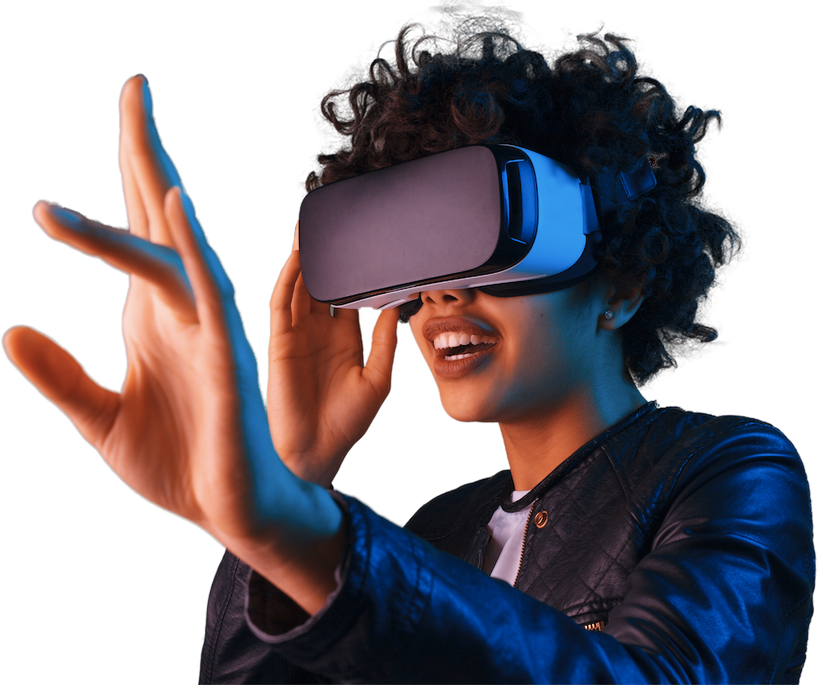
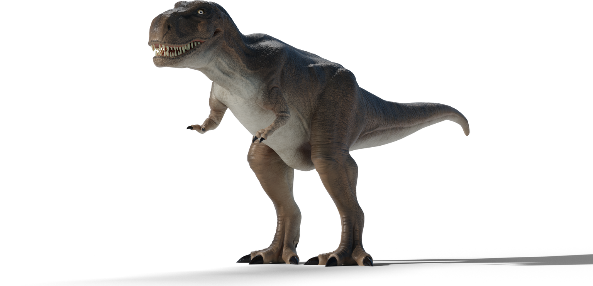
PREHISTORICAL VR SIMULATION AS
AN EDUCATIONAL CONTENT
R25-056
Final Presentation

Slide 2


INTRODUCTION TO THE OVERALL PROJECT
Context
Static learning doesn’t trigger curiosity or memory. We tested if interactive VR with AI-driven animal behaviour could make people understand and remember better.
Problem
Students & public have limited access to detailed content
Lack of immersive ,memorable learning opportunities
Our Project
Focus: Mesozoic Era content
Solution: 3 interactive simulations + Virtual Guide
Aim: Deliver engaging, interactive learning beyond traditional learning mediums

Slide 3

RESEARCH PROBLEM
Static learning doesn’t trigger curiosity or memory. We tested if interactive VR with AI-driven animal behaviour could make people understand and remember better.

Slide 4
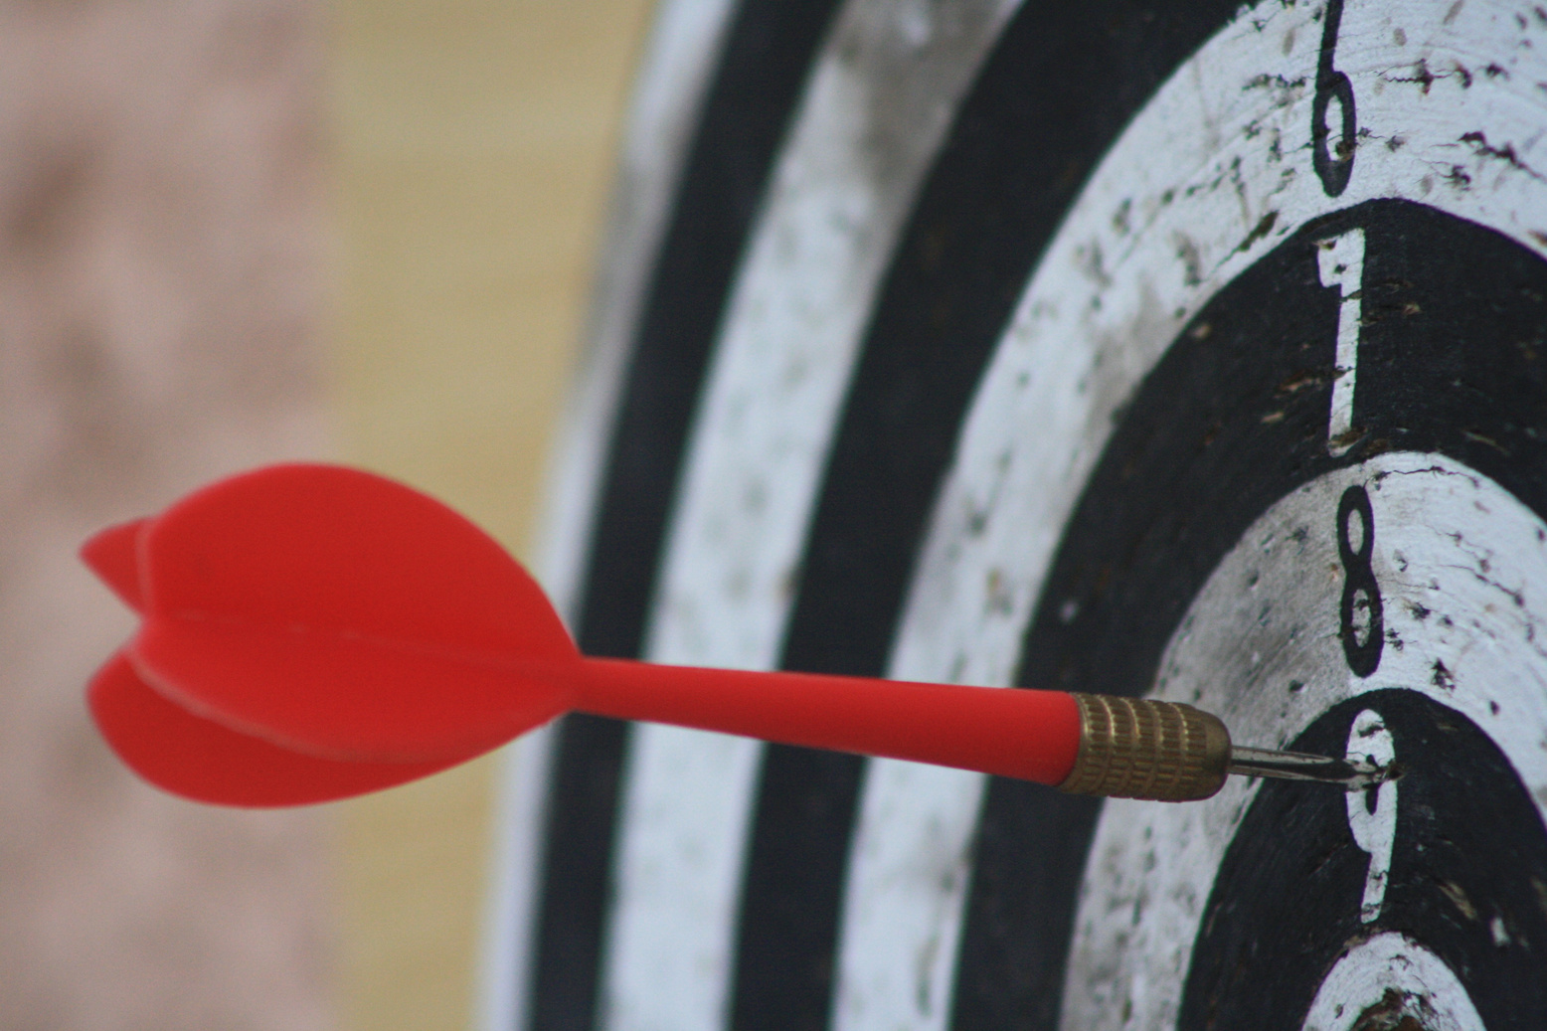
RESEARCH OBJECTIVES
o design a VR simulation that shows realistic prehistoric animal behaviours — hunting, herding, feeding and see if this boosts learning, focus, and enjoyment.

Slide 5

RESEARCH COMPONENTS
Prehistoric VR Timeline
Extinction Event Simulation
Prehistoric Animal Behaviour Simulation
Virtual Guide

Slide 6


M M Ilangamveera
IT 21284502
Prehistoric VR Timeline
IT21284502
|
M M Ilangamveera
|
R25-056

Slide 7

BACKGROUND
A VR application as an enhancement for traditional visual timelines
Focus on engaging, and suitable content for general audiences
Combines 360 environments, narration, pre-questions, micro-interactions and a simple puzzle gamifications to enhance learning, curiosity and memory retention
IT21284502
|
M M Ilangamveera
|
R25-056

Slide 8
Gaps
No Memory retention ,attention improving techniques
No Interactivity
IT21284502
|
M M Ilangamveera
|
R25-056

Slide 9

RESEARCH PROBLEM
Can we teach people about prehistoric timelines better using VR interactive timeline that includes narration, Pre questions interactions and gamifications ?
IT21284502
|
M M Ilangamveera
|
R25-056

Slide 10

SPECIFIC AND SUB OBJECTIVES
Deliver concise and engaging content on Mesozoic ecosystems in a short time
Design simple yet memorable VR interactions for all age groups (12+)
Enhance knowledge retention using VAK learning modes (kinesthetic, auditory, visual) and pre-questions & Gamifications
IT21284502
|
M M Ilangamveera
|
R25-056

Slide 11
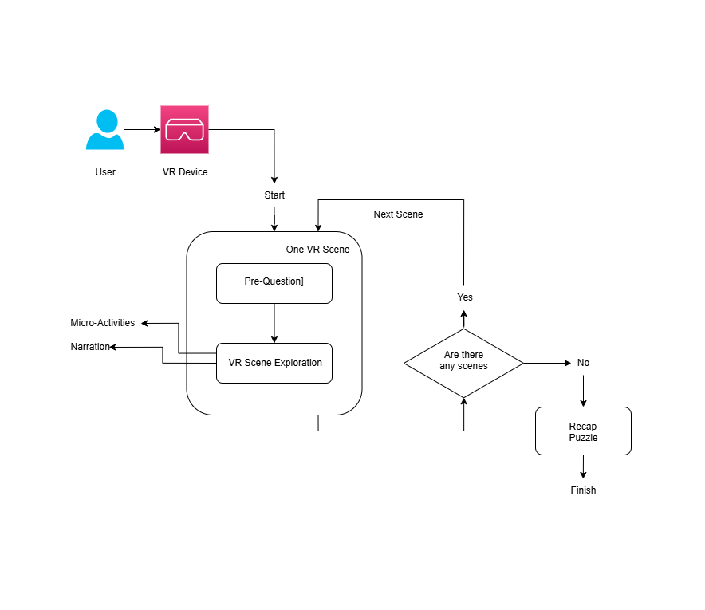
SYSTEM DIAGRAM
IT21284502
|
M M Ilangamveera
|
R25-056

Slide 12



TECHNOLOGIES TO BE USED
Unity 2022
Blender
VS Code
XR SDKs
IT21284502
|
M M Ilangamveera
|
R25-056

Slide 13

FUNCTIONALITY
User will get a Pre-Question based on the content visitor is about to learn and user can select one of the 2 answers
user will hear a narration and see the sceneries to learn the content
user will have a chance to have micro-interaction with an environmental element and animals (Controller interactions ,Virtual triggers )
IT21284502
|
M M Ilangamveera
|
R25-056

Slide 14
Completed Component
3 Mesozoic Periods
12 Scenes
Recap Puzzle
IT21284502
|
M M Ilangamveera
|
R25-056

Slide 15
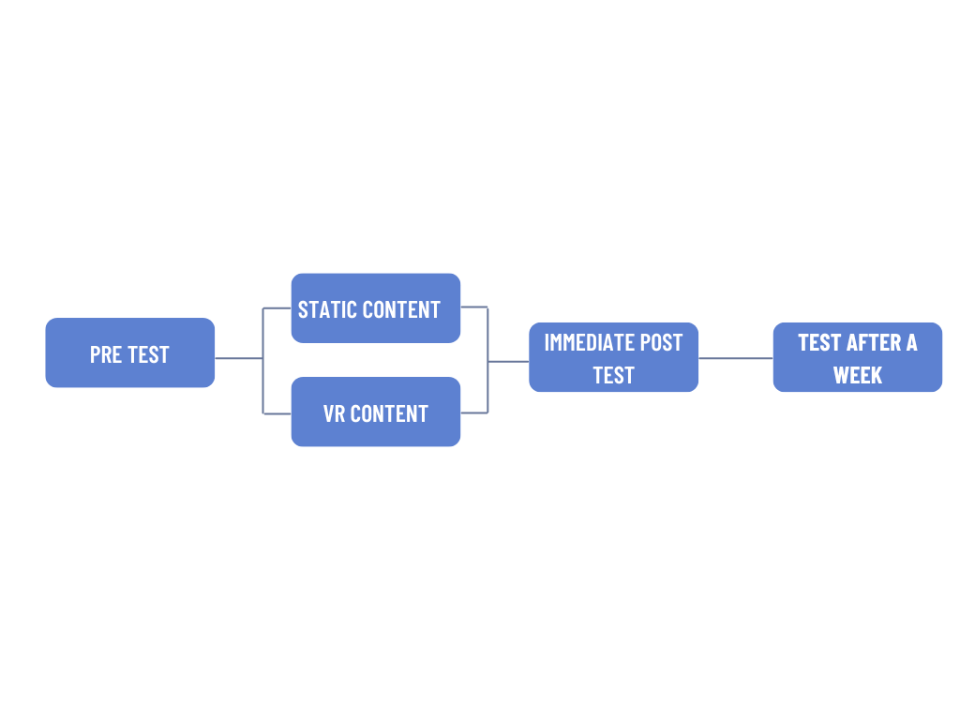
User testing Methodology
26 participants
Testing Purpose
Compare between Static methods and this VR system
IT21284502
|
M M Ilangamveera
|
R25-056

Slide 16
Testing Metrics
Knowledge Gain (%) - Improvement from pre- to post-test
Retention (%) - Knowledge kept after 7 days
Engagement Scores - Enjoyment, Focus, Clarity, Curiosity, Recommend (1–5 scale)
IT21284502
|
M M Ilangamveera
|
R25-056

Slide 17
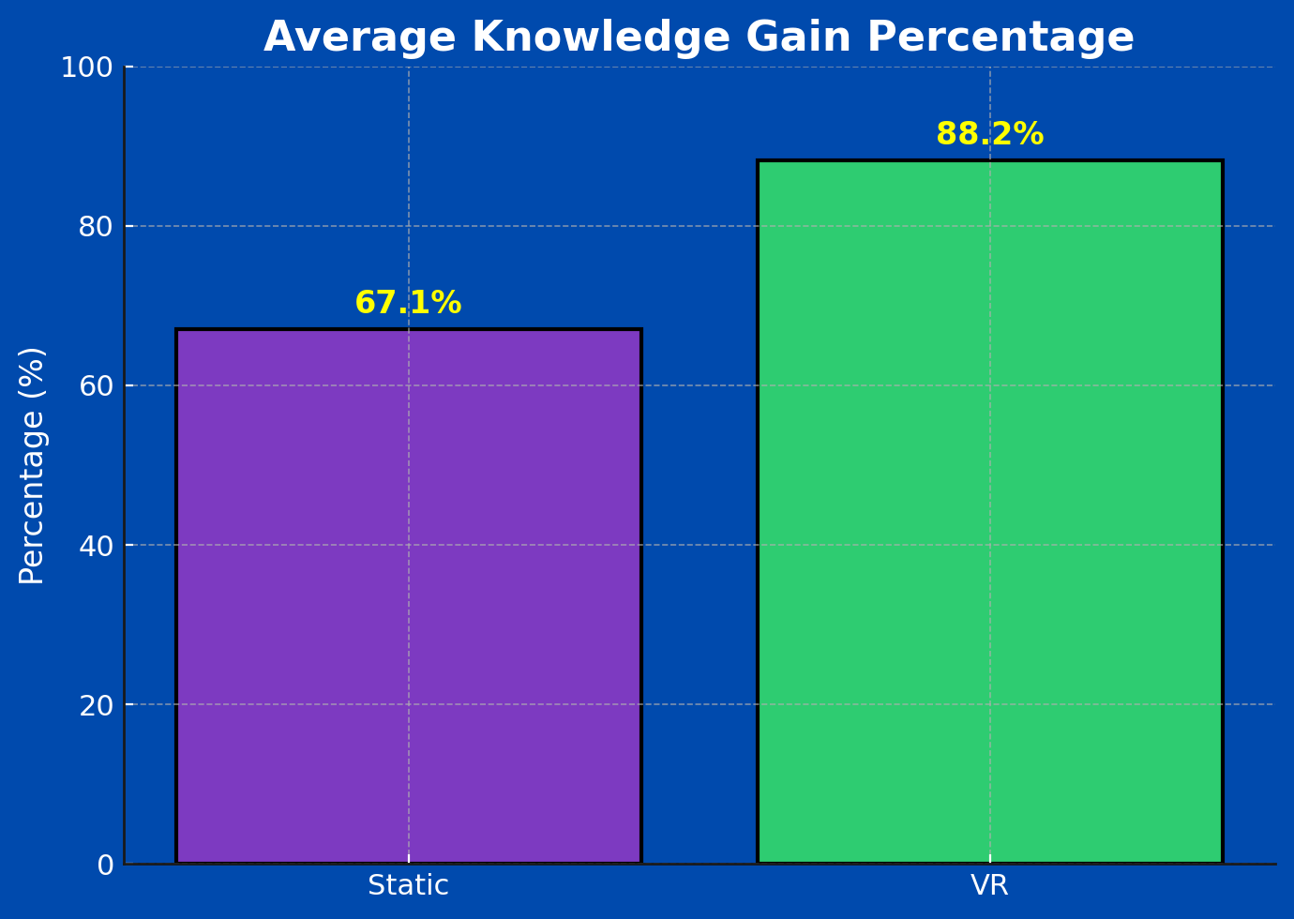
Average Knowledge Gain percentage
IT21284502
|
M M Ilangamveera
|
R25-056

Slide 18
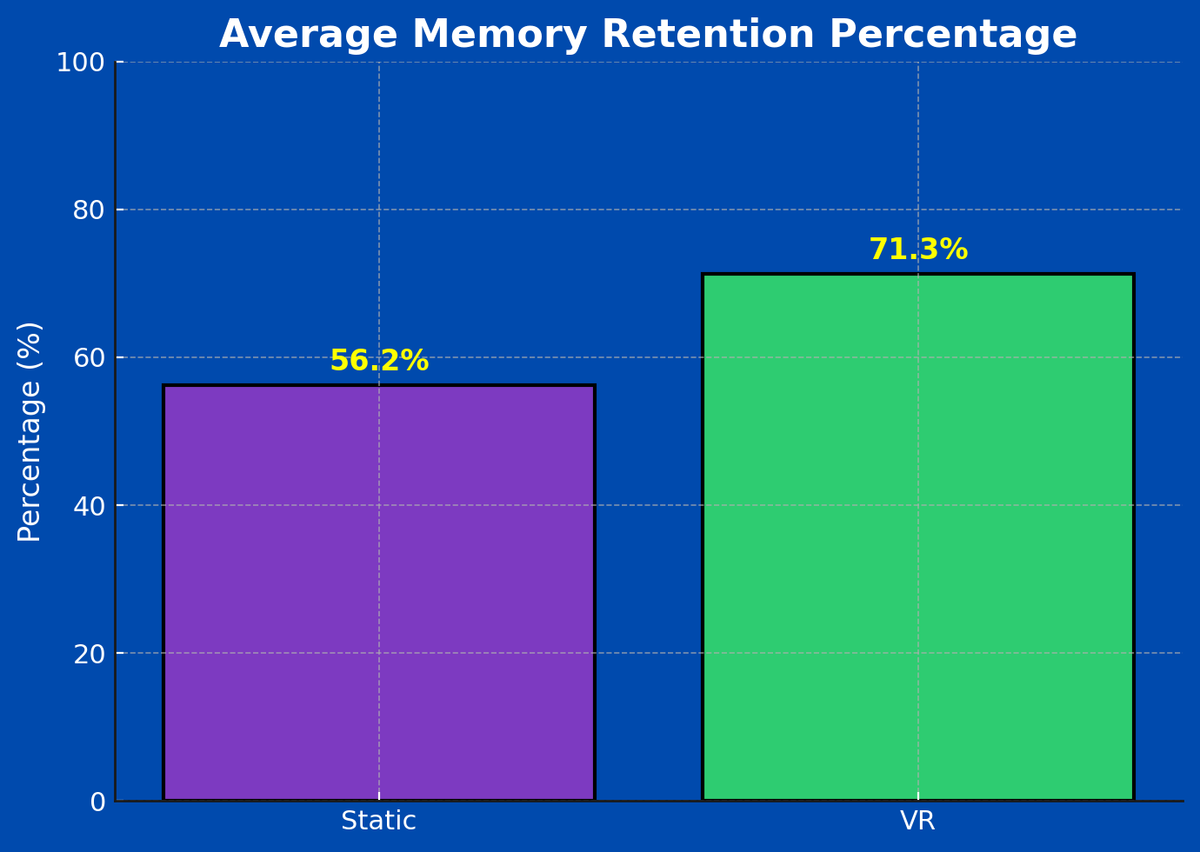
Average Memory Retention percentage
IT21284502
|
M M Ilangamveera
|
R25-056

Slide 19
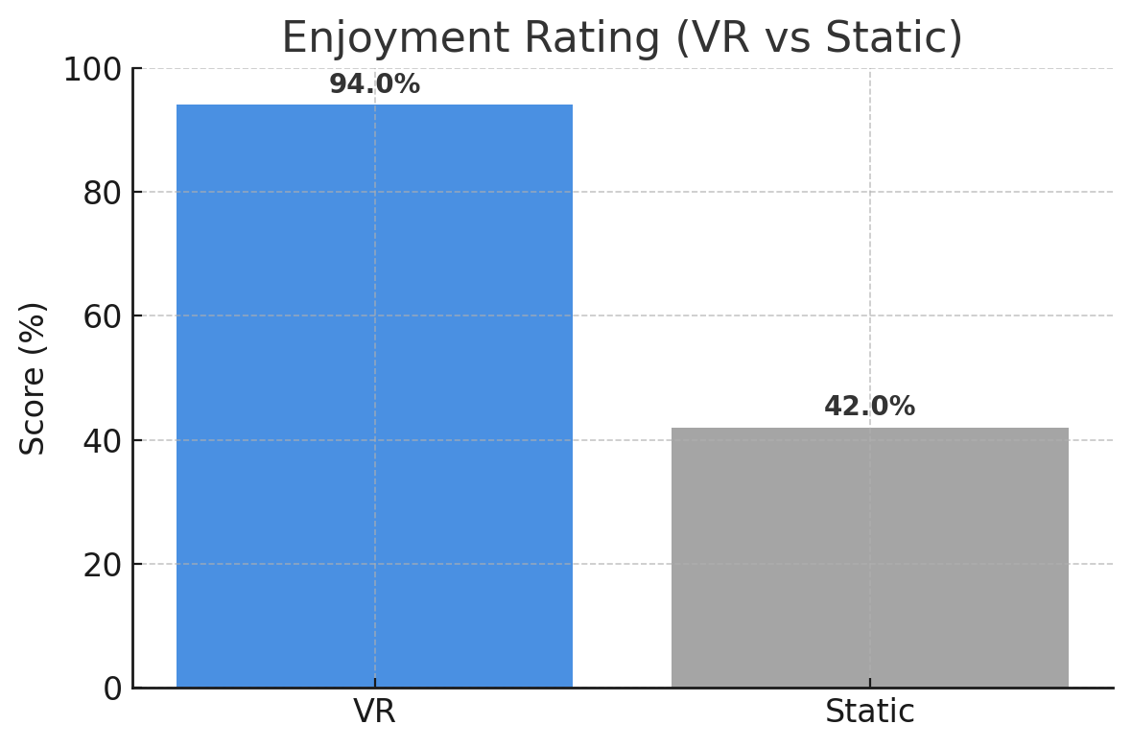
Engagement Metrics
IT21284502
|
M M Ilangamveera
|
R25-056

Slide 20
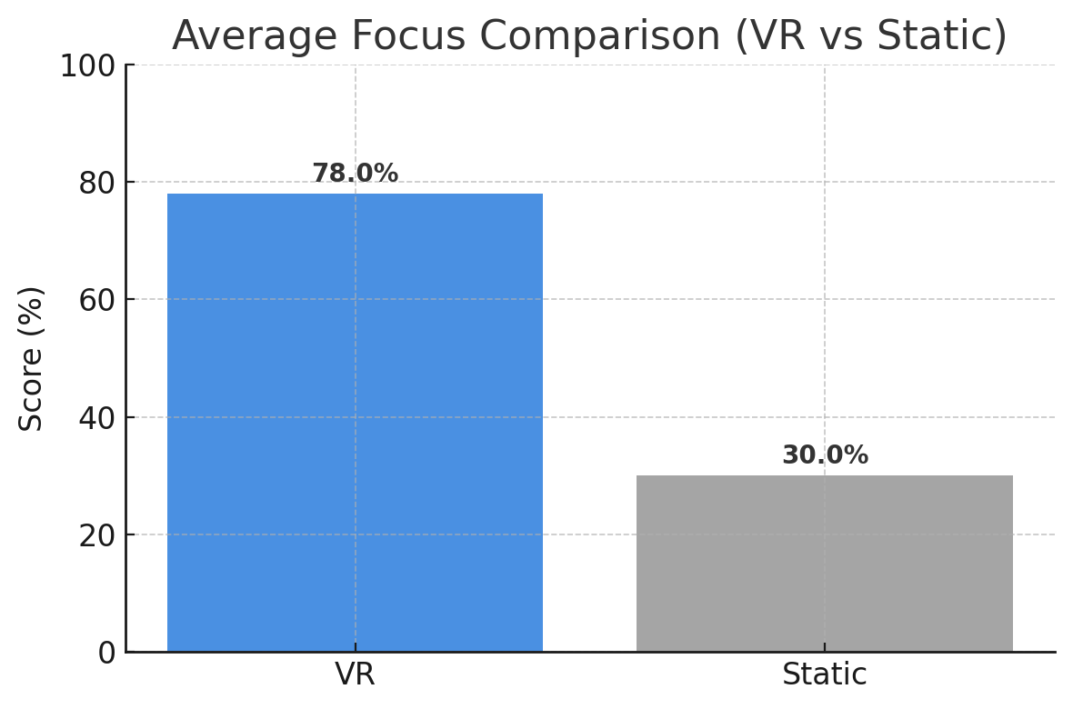
Engagement Metrics
IT21284502
|
M M Ilangamveera
|
R25-056

Slide 21
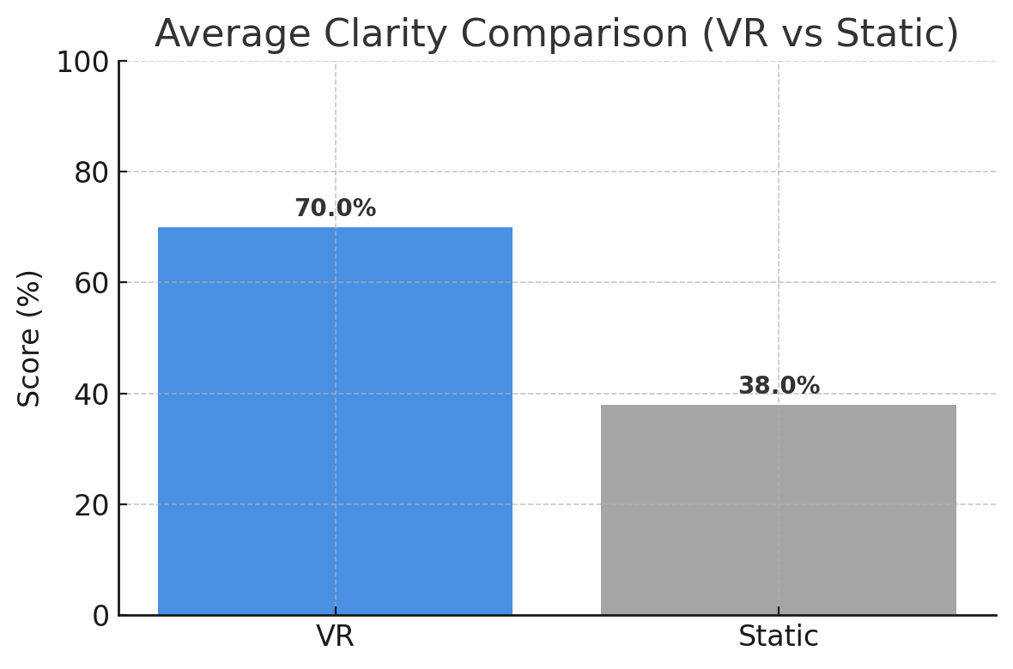
Engagement Metrics
IT21284502
|
M M Ilangamveera
|
R25-056

Slide 22
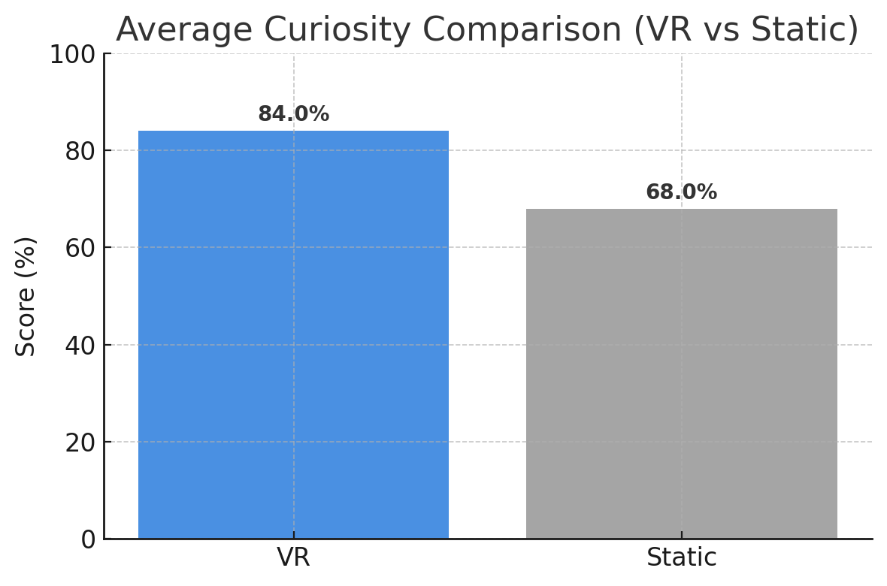
Engagement Metrics
IT21284502
|
M M Ilangamveera
|
R25-056

Slide 23
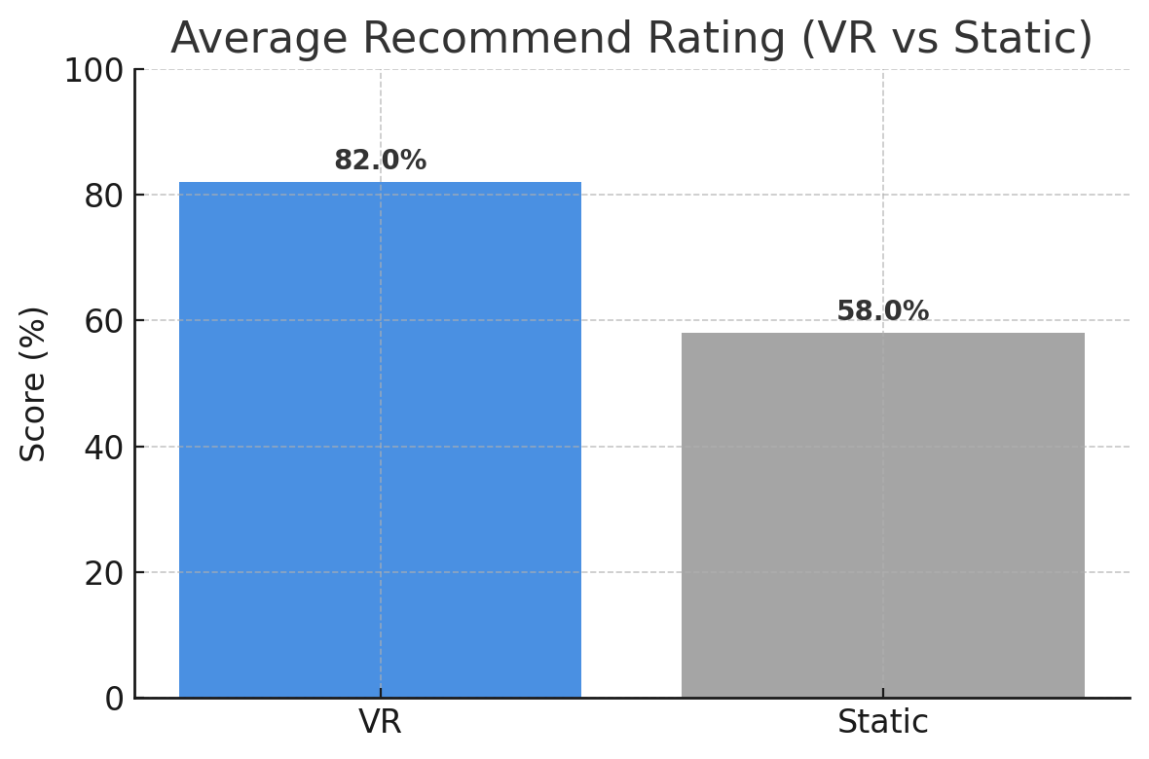
Engagement Metrics
IT21284502
|
M M Ilangamveera
|
R25-056

Slide 24
Summery Of Outcomes
VR Application got +21% higher learning gain
VR Application got +15% Stronger retention
VR application received higher scores across all metrics
IT21284502
|
M M Ilangamveera
|
R25-056

Slide 25
References
Research Publications
[1] O. Ofianto, A. Aman, S. Sariyatun, B. Bunari, T. Z. N. Zahra, and M. E. P. Marni, “Media
Timeline Development with the Focusky Application to Improve Chronological Thinking Skills,”
International Journal of Learning, Teaching and Educational Research, vol. 21, no. 4, pp. 114–
133, Apr. 2022, doi: 10.26803/ijlter.21.4.7.
[2] P. Vatanasirisuk, Exploring Historical Events Through an Interactive Timeline [Online].
Graduate thesis, Visual Communication Design, School of Design, Rochester Institute of
Technology, 2021. Available: https://repository.rit.edu/theses/10757
Other References
https://www.educationcorner.com/the-learning-pyramid/
IT21284502
|
M M Ilangamveera
|
R25-056

Slide 26
Thank You

Slide 27
Dissanayake J S
IT 21318870
VR extinction event simulation
iT21318870
|
Dissanayake JS
|
R25-056

Slide 28
BACKGROUND
66 million years ago K - Pg extinction event eliminated ~75% of Earth’s species.
Traditional learning methods (books, videos) fail to show the scale and dynamics of the event.
VR provides immersion, interactivity, and emotional engagement.
Combines education + technology for experiential learning.
IT21318870
|
Dissanayake J S
|
R25-056

Slide 29
RESEARCH PROBLEM
Current paleontology education lacks interactive simulations.
Students struggle to understand dynamic environmental changes.
How can VR be used to create scientifically accurate, immersive learning experiences?
IT21318870
|
Dissanayake J S
|
R25-056

Slide 30
Gaps
Most existing VR education tools are static or pre-recorded.
Lack of real-time interactivity and scientific accuracy.
Few focus on paleontology or mass extinctions.
Need for dynamic, educational, and AI-driven VR systems.
IT21318870
|
Dissanayake J S
|
R25-056

Slide 31
SPECIFIC AND SUB OBJECTIVES
Main Objective:
Develop an immersive VR simulation of the K–Pg extinction event.
Sub Objectives:
Recreate pre-impact, impact, and post-impact environments.
Implement AI dinosaur behavior using NavMesh.
Integrate realistic lighting, sound, and particle effects.
Optimize for smooth VR performance.
Evaluate educational impact through user testing.
IT21318870
|
Dissanayake J S
|
R25-056

Slide 32
TECHNOLOGIES TO BE USED
Unity 2022
Blender
VS Code
XR SDKs
IT21318870
|
Dissanayake J S
|
R25-056

Slide 33
FUNCTIONALITY
Three major scenes: Pre-Impact, Impact, and Post-Impact.
Whistle to call dinosaurs; pick up and drop stones to trigger reactions.
Dynamic lighting, sound, and weather transitions.
Performance optimization with occlusion culling and LOD.
IT21318870
|
Dissanayake J S
|
R25-056

Slide 34
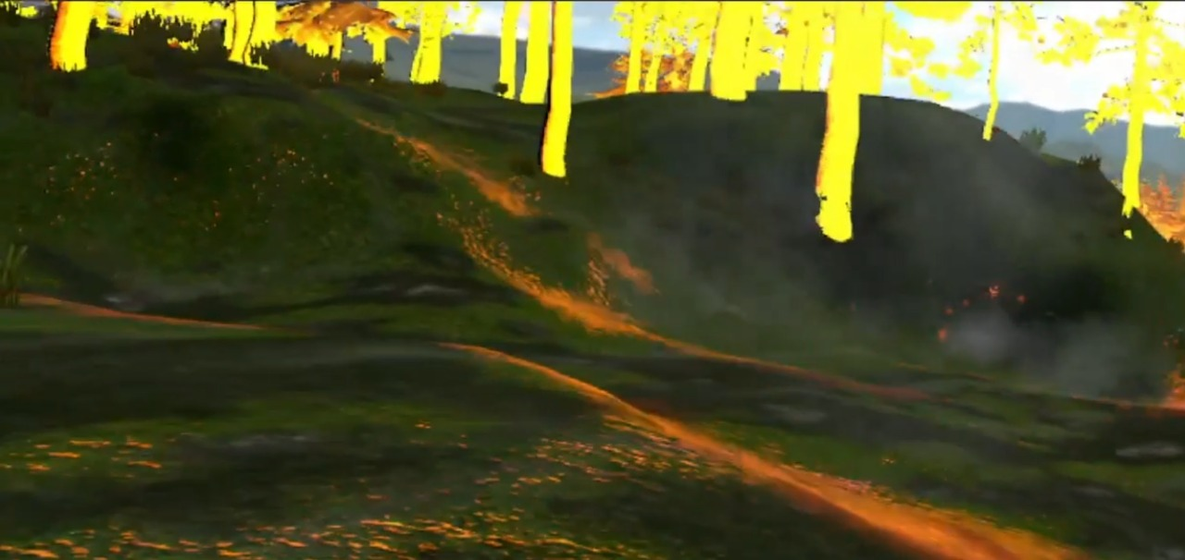
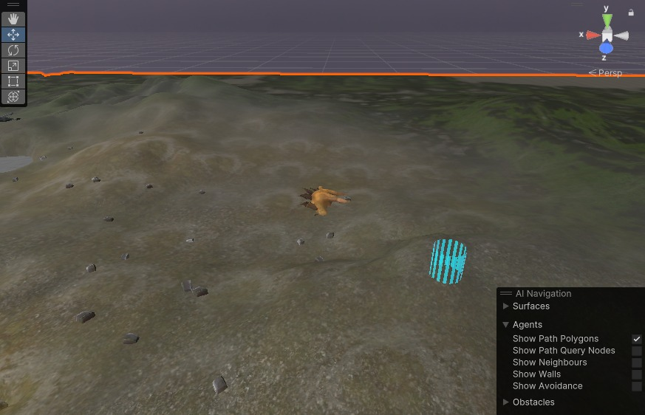
Completed Project
3 Scenes
Cretaceous Paleogene Period
Extinction event
IT21318870
|
Dissanayake J S
|
R25-056

Slide 35
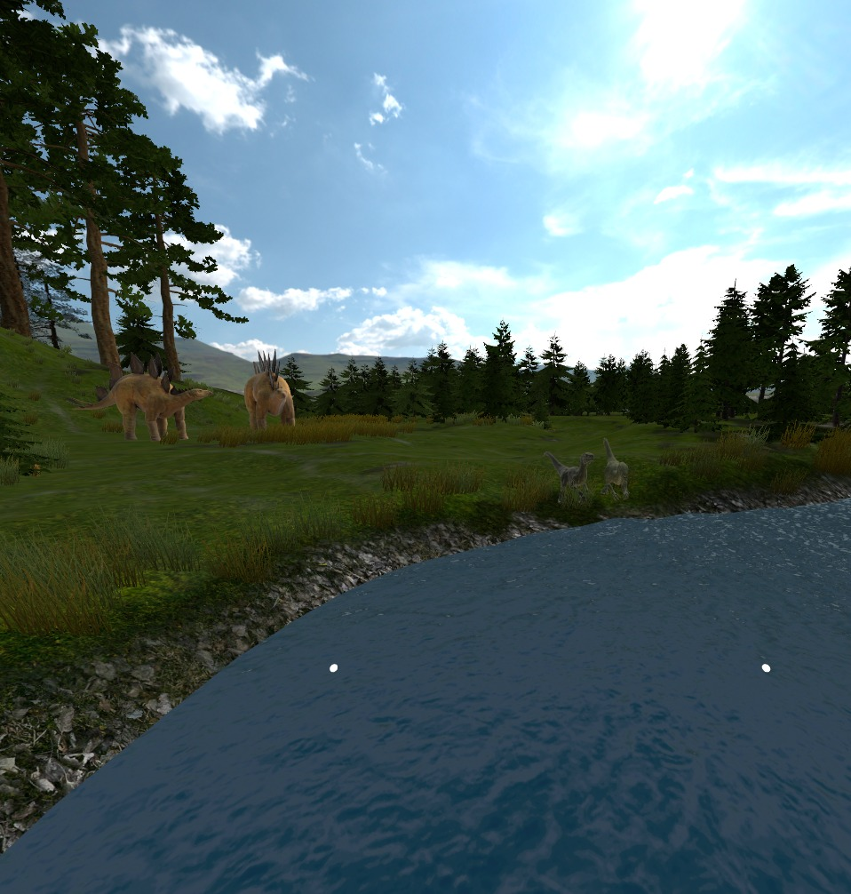
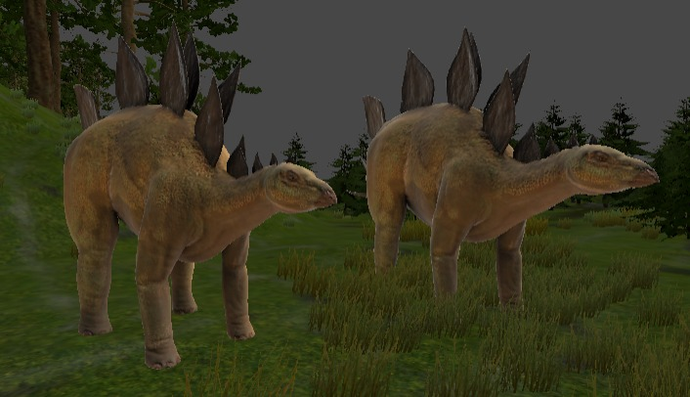
Completed Project
IT21318870
|
Dissanayake J S
|
R25-056

Slide 36
User testing Methodology
10 participants
between-subject comparison (Static vs VR)
IT21318870
|
Dissanayake J S
|
R25-056

Slide 37
Testing Metrics
10 participants
Pre-test and post-test quizzes.
Metrics: learning improvement, comfort, engagement, realism.
Average score improvement: 60% → 85%.
Usability rating: 4.6/5.
IT21318870
|
Dissanayake J S
|
R25-056

Slide 38
Average gain percentage
Static
VR
IT21318870
|
Dissanayake J S
|
R25-056

Slide 39
Engagement Metrics
Engagement Metrics
Engagement Metrics
Engagement Metrics
Engagement Metrics
Static
VR
Static
VR
Static
VR
Static
VR
IT21318870
|
Dissanayake J S
|
R25-056

Slide 40
Summery Of Outcomes
Enhanced understanding of environmental change and extinction.
Significant improvement in learning retention.
Technically and educationally feasible.
Can be extended for museums and schools.
Contributes to Sri Lanka’s digital education initiatives.
IT21318870
|
Dissanayake J S
|
R25-056

Slide 41
References
Research Publications
H. Slater, “VR for Paleontology: New Approaches to Ancient Environments,” Nature
Education, vol. 7, no. 2, pp. 45–50, 2022.
. J. Bohannon, “Mass Extinction Triggered by Asteroid Impact,” Science Magazine, vol. 376,
no. 6589, pp. 101–104, 2022.
S. W. Choi and Y. S. Kim, “Virtual Reality Museums: A New Era of Digital Heritage,”
Journal of Heritage Science, vol. 10, 2022.
National Geographic, “The Day the Dinosaurs Died,” NatGeo Science Feature, 2020.
Other References
https://www.educationcorner.com/the-learning-pyramid/
IT21318870
|
Dissanayake J S
|
R25-056

Slide 42
Thank You
IT21318870
Dissanayake J S
R25-056
|
|

Slide 43
Kodithuwakku A K
IT 21231582
PrehistoricAnimal Behaviour Simulation
IT21231582
|
Kodithuwakku AK
|
R25-056

Slide 44
BACKGROUND
We built the simulation in Unity 2022 with ML-Agents, NavMesh, and environmental physics.
Each species acts naturally: predators stalk, herbivores herd, and users can safely observe or feed them.
The goal was realism that still works smoothly for education.
IT21231582
|
Kodithuwakku AK
|
R25-056

Slide 45
Gaps
No real-time interactivity in traditional exhibits
No behavour-based teaching on prehistoric life
Limited use of AI in museum learning content
IT21231582
|
Kodithuwakku AK
|
R25-056

Slide 46
RESEARCH PROBLEM
Can AI-based behavioural simulation in VR improve understanding of prehistoric ecosystems compared to static visuals?
IT21231582
|
Kodithuwakku AK
|
R25-056

Slide 47
SPECIFIC AND SUB OBJECTIVES
Use AI and ML-Agents to make animal reactions adaptive and believable.
Simulate realistic prehistoric animal behaviours such as feeding, herding, and hunting.
Ensure performance is smooth and intuitive for all age groups (12+)
IT21231582
|
Kodithuwakku AK
|
R25-056

Slide 48
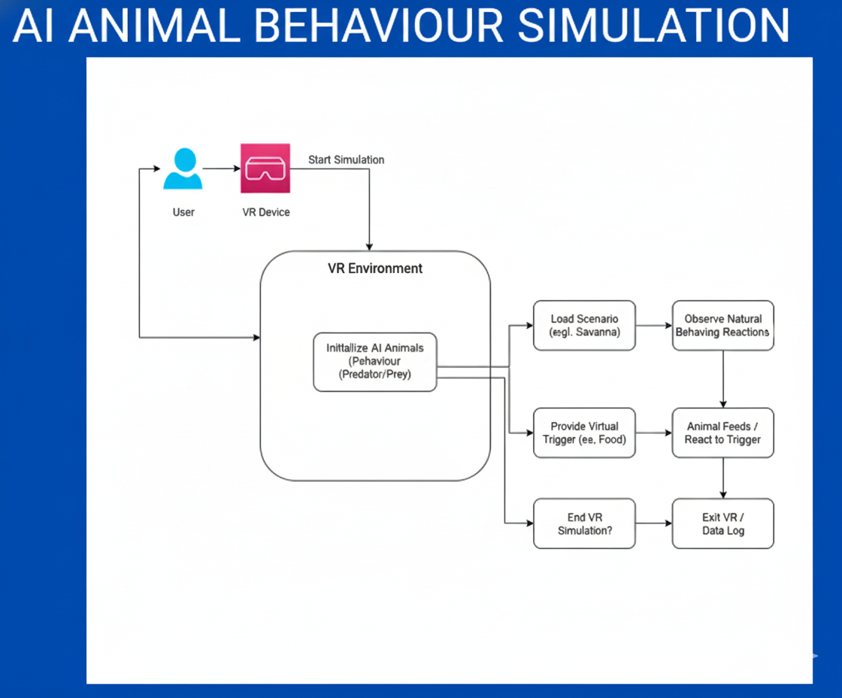
SYSTEM DIAGRAM
IT21231582
|
Kodithuwakku AK
|
R25-056

Slide 49
TECHNOLOGIES
Unity 2022
Blender
VS Code
XR SDKs
IT21231582
|
Kodithuwakku AK
|
R25-056

Slide 50
FUNCTIONALITY
Animals behave realistically using AI — hunting, grazing, and herding based on environment triggers
Users can interact through feeding, observing, or moving within the VR space.
Narration and micro-activities guide learning while maintaining immersion.
IT21231582
|
Kodithuwakku AK
|
R25-056

Slide 51
Completed Project
01 Scenes
3 animal behavours
Integration with ML agents
IT21231582
|
Kodithuwakku AK
|
R25-056

Slide 52
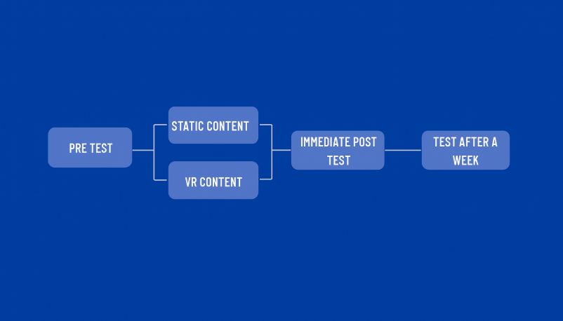
User testing Methodology
26 participants
between-subject comparison (Static vs VR)
IT21231582
|
Kodithuwakku AK
|
R25-056

Slide 53
Testing Metrics
Gain (%) - Improvement from pre- to post-test
Gain (%) - Improvement from pre- to post-test
Retention (%) - Knowledge kept after 7 days
Engagement Scores-Enjoyment, Focus, Clarity, Curiosity, Recommend (1–5 scale)
IT21231582
|
Kodithuwakku AK
|
R25-056

Slide 54
Average gain percentage
Static
VR
IT21231582
|
Kodithuwakku AK
|
R25-056

Slide 55
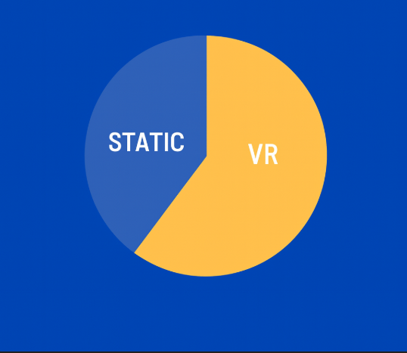
Average Retention percentage
IT21231582
|
Kodithuwakku AK
|
R25-056

Slide 56
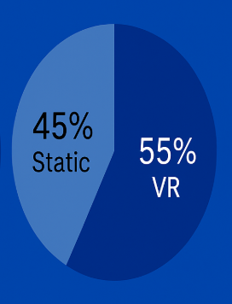
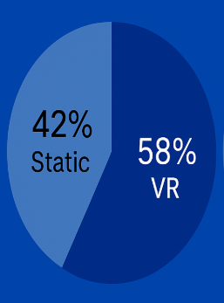
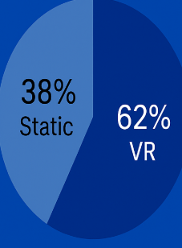
Engagement Metrics
IT21231582
|
Kodithuwakku AK
|
R25-056

Slide 57
Summery Of Outcomes
VR Application got +21% higher learning gain
VR Application got +15% Stronger retention
VR Application got 2X enjoyment and focus
IT21231582
|
Kodithuwakku AK
|
R25-056

Slide 58
References
Research Publications
[1] E. Turan and G. Çetin, “Using artificial intelligence for modeling of the realistic animal behaviors in a virtual island,” Computer Standards & Interfaces, vol. 66, p. 103361, Jun. 2019.
[2] H. Naik, R. Bastien, N. Navab, and I. Couzin, “Animals in Virtual Environments,” arXiv preprint arXiv:1912.12763, Jan. 2020
IT21231582
|
Kodithuwakku AK
|
R25-056

Slide 59
Thank You
IT21231582
|
Kodithuwakku AK
|
R25-056

Slide 60
Waynath S.P.K
IT 21803420
Virtual Guide
IT21803420
|
Waynath S.P.K
|
R25-056

Slide 61
BACKGROUND
VR application serves as the interface to interact with the Virtual Guide
Focused on delivering accurate, real-time answers to user questions
Engages users in an educational and natural manner, similar to a teacher
IT21803420
|
Waynath S.P.K
|
R25-056

Slide 62
RESEARCH PROBLEM
AI-based guides today can generate human-like text and speech but struggle to understand their environment.
Without spatial awareness, they cannot adapt their responses to the user’s surroundings, resulting in limited contextual guidance.
This creates a need for virtual guides that combine natural language capabilities with scene understanding to deliver more effective, context-aware assistance.

Slide 63
RESEARCH GAP
Current AI guides excel at generating text and speech but lack spatial awareness.
They cannot perceive or adapt to their environment, which limits their ability to provide context-aware assistance.
There is a clear gap in developing AI-powered guides that understand scenes within their surroundings, enabling more natural, situational, and useful interactions.
IT21803420
|
Waynath S.P.K
|
R25-056

Slide 64
RESEARCH OBJECTIVES
Main objective
To develop an AI-powered Virtual Guide that integrates spatial awareness with natural language understanding and speech, enabling context-aware, adaptive, and human-like guidance in interactive environments.

Slide 65
SPECIFIC AND SUB OBJECTIVES
Deliver educational and engaging content on Mesozoic ecosystems based on the users questions
Design a system that is capable for all age groups
Design a system that will guide the user to exhibits in the museum
IT21803420
|
Waynath S.P.K
|
R25-056

Slide 66
FUNCTIONALITY
User will be able to ask the guide questions and will get an answer
user will hear a narration by the guide based on the users question
user will have the ability to toggle between the guide interface in order to view exhibits
IT21803420
|
Waynath S.P.K
|
R25-056

Slide 67




TECHNOLOGIES TO BE USED
Unity 2022
Ollama
Flask
VS Code
C#
XR SDKs
Python
IT21803420
|
Waynath S.P.K
|
R25-056

Slide 68
Completed Project
1 Scene 3 Exhibits which are represented by dinosaur skeletons
The exhibits are Triceratops, Tyranosaurus Rex & Plateosaurus
Conversational Guide with Spatial Understanding (understands the environment)
IT21803420
|
Waynath S.P.K
|
R25-056

Slide 69
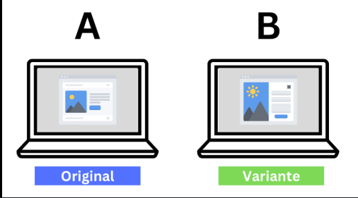
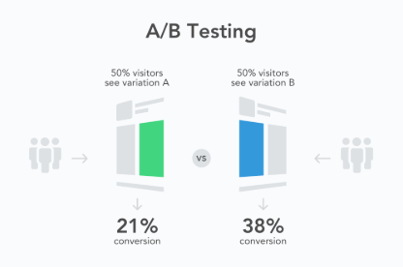
User Testing Methodology
IT21803420
|
Waynath S.P.K
|
R25-056

Slide 70
Testing Metrics
Customization Quality (single-item (or averaged Likert) rating of how well the system adapts to the user/task.)
Time-to-First-Useful-Fact
IT21803420
|
Waynath S.P.K
|
R25-056

Slide 71
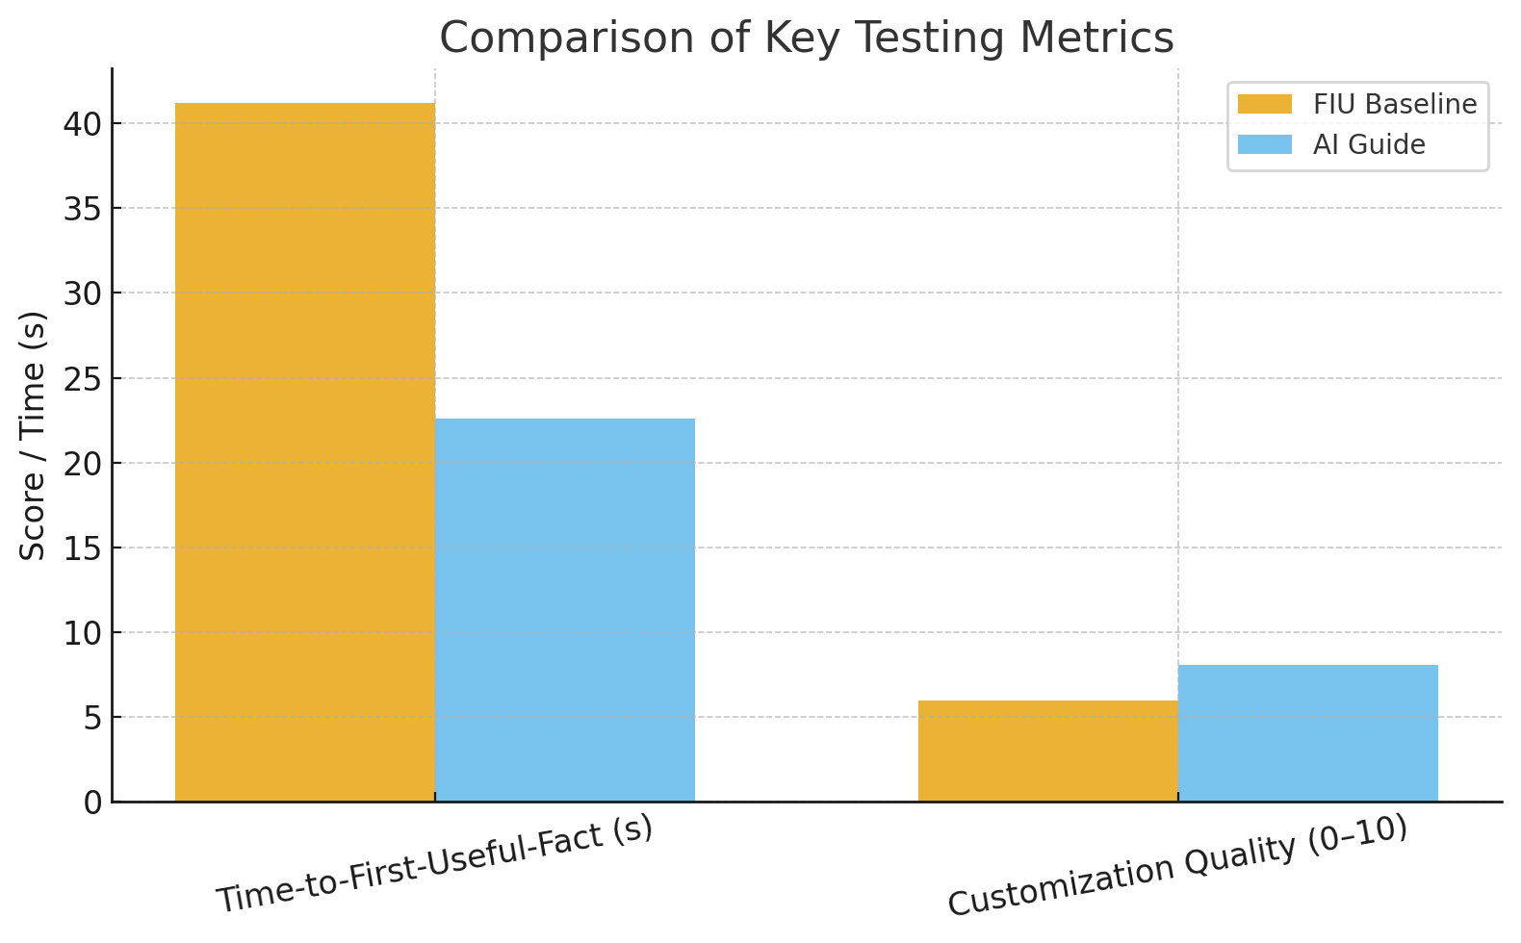
IT21803420
|
Waynath S.P.K
|
R25-056

Slide 72
Summary of Outcomes
Tailored-info success (% of requests hitting ≥8/10 on rubric): FIU 58% vs AI Guide 66%.
IT21803420
|
Waynath S.P.K
|
R25-056

Slide 73
References
[1] J. Cimadevilla, R. Nori, L. Piccardi, Application of Virtual Reality in Spatial Memory, 2023
[2] Vijay Kumar Chhabra, Rohit Sachdeva, Pargat Singh Garcha, VISUALIZING THE FUTURE: AN OVERVIEW OF AR, VR, AND SPATIAL AWARENESS IN THE DIGITAL AGE, 2024
[3] S. Papagiannakis, N. Magnenat-Thalmann, and M. D. Gross, “Mixed reality agents as museum guides,” in Proceedings of the 2005 International Conference on Virtual Systems and Multimedia (VSMM’05), Ghent, Belgium, 2005, pp. 304–313. doi: 10.1109/VSMM.2005.148
[4] C. Pelachaud, I. Poggi, and F. de Rosis, “Adaptive multimodal perception for a virtual museum guide,” in Proc. Intelligent Virtual Agents (IVA), Springer, 2005, pp. 409–420. doi: 10.1007/11550617_34
[5] N. D. Roussakis and E. L. Boiano, “Talking triples to museum chatbots: Knowledge graph-driven conversational agents for cultural heritage,” in Proc. Museums and the Web Conf., 2019, pp. 1–12.
[6] A. Ressi and B. Di Marzo Friha, “AI in GLAMs: Intelligent agents, holographic avatars and digital twins for galleries, libraries, archives, and museums,” in Proc. ACM CHI Conf. Human Factors in Computing Systems (CHI’25), 2025, pp. 1–10.
[7] M. Chen, G. Fei, C. Shi, and L. Wang, “Context-aware mixed reality: A learning-based framework for semantic-level interaction,” Computer Graphics
IT21803420
|
Waynath S.P.K
|
R25-056

Slide 74
Thank You
IT21803420
|
Waynath S.P.K
|
R25-056

